Slide 1
Design And Analysis Of Algorithms-Assignment 5
GROUP 2:
ADITYA RAJ IIT2017005
MAYANK MRINAL IIT2017006
MOHIT PAHUJA IIT2017007
ARASHPREET SINGH IIT2017008

Slide 2
PROBLEM
We are required to merge two sorted subsequences into a sorted sequence in most optimal way.

Slide 3
INTRODUCTION
➔ For this problem ,we have used an additional array to store the result. The size of the array is equal to the sum of the size of two sorted subsequence. We have compared the consecutive element and eventually store the result to the final array.

Slide 4
ALGORITHM
We take both the sorted subsequences and their sizes as input. We have initialized three pointers which would point to the elements of first, second and the final array.
We have compared the pointed elements of the first and second array.
Now we append the smaller of these to the final array and increment the pointer of the array having smaller element and the final array.
When one of the array exhaust we append the elements of the other array directly to the final array. The final array is the required sorted sequence.

Slide 5
PSEUDOCODE

Slide 6
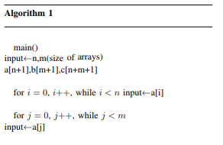
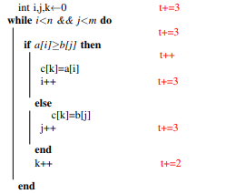

Slide 7
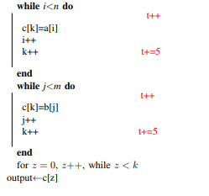

Slide 8
ALGORITHM ANALYSIS
TIME COMPLEXITY
• We have calculated the time consumed in each step in terms of number of computations, as given in the above pseudo code
• As the time complexity depends on the movement of pointer and that depends on the elements of the subsequences and also their size.
• We observe that the best case complexity is encountered when the consecutive elements of the final array lie in different subsequences upto twice the length of the smaller subsequence. Thus the best case complexity is O(max(m,n)).

Slide 9
ALGORITHM ANALYSIS
TIME COMPLEXITY
• We observe that the worst case complexity is encountered when all the element of first the subsequence is smaller than each element of second subsequence or vice-versa.T hus the worst case complexity is O(m+n).
• The average case complexity lies between O(m+n) and O(max(m,n)).

Slide 10
SPACE COMPLEXITY
We have used two arrays for storing the given subsequences and a final array of the size equal to the sum of the sizes of the previous two arrays.
We compute the space complexity as O(n)+O(m)+O(m+n) which is equal to O(2(m+n))=O(m+n).
Therefore the space complexity comes out to be O(m+n).

Slide 11
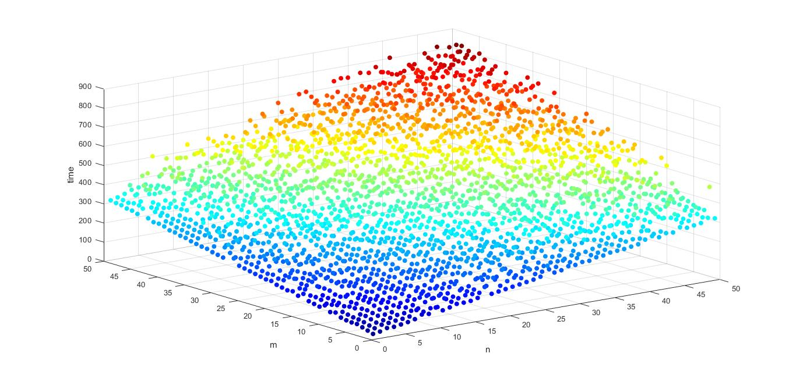
TIME COMPLEXITY
GRAPH

Slide 12
1. The graph depicts, our calculation, that is the algorithm takes O(m+n) time is complied. . 2. The integrated Development environment of C++ is used for processing the algorithm and graphical analysis is done using MATLAB scatter3 function.
EXPERIMENTAL STUDIES

Slide 13
CONCLUSION
In this document we conclude that our algorithm has time complexity equal to O(m+n) and the space complexity is of O(m+n).

Slide 14
REFERENCES
1.[CLR96] Thomas H. Cormen, Charles E. Leiserson, and
Ronald L Rivest. Introduction to algorithms. The MIT press,
2nd edition, 1996.
2.[DW96] Nell Dale and Henry M. Walker. Abstract data
types: specifications, implementations, and applications. D.
C. Heath and Company, Lexington, MA, USA, 1996.

Slide 15
THANK YOU

